Slide 1
FAST FOOD ANALYSIS
BURGER KING
Objective : Analyse Burger King menu data
Provide insights, solutions, and recommendations
Focus: Nutrition, customer health and business strategy.

Slide 2
Dataset Overview
* Dataset covers multiple fast-food chains
* Selected Focus: Burger King items
* Key Variables analysed:
Calories, Fat(g), Sodium(g), Protein(g)
Item category (Burger, Chicken, Salad, etc.)
* Burger King average Values:
Calories ~ 608 per item
Sodium ~ 1,200mg per item
Protein ~ 30g per item

Slide 3
Diagnostic Insights
High Calorie Items: Whooper & specialty burgers exceed 900-1200 calories.
Sodium Levels: Some burgers cross 2,200+ mg sodium (above daily limit)
Protein Trade-off: Burgers are protein- rich but high in fat/sodium
Healthier Options: Grilled chicken sandwiched & salads.

Slide 4
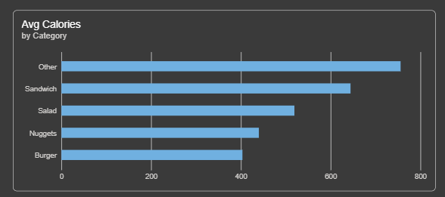
Average Calories by Food Category
The bar chart compares average calories across categories like Sandwich, Salad, Nuggets, Burger, and Others.
It shows that “Other” items and sandwiches are the most calorie‑dense, while burgers average lower.
This slide highlights which food types contribute most to calorie intake.

Slide 5
Solutions
Menu Optimization: Promote grilled chicken and small burgers
Nutritional Transparency: Display Calorie/sodium info on menu and apps
Product Innovation: Reduce Sodium in sauces, introduce whole-grain buns
Portion Control: Offer “mini” version of popular burgers

Slide 6
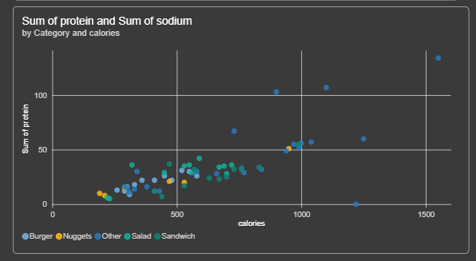
Nutritional Relationship: Calories vs Protein Across Categories
The scatter plot shows how higher‑calorie items generally deliver more protein, but also carry high sodium levels.
Burgers and sandwiches cluster at the top, proving they are calorie‑dense and protein‑rich but nutritionally imbalanced.
This visual supports by highlighting the trade‑off between protein benefits and sodium risks across categories.

Slide 7
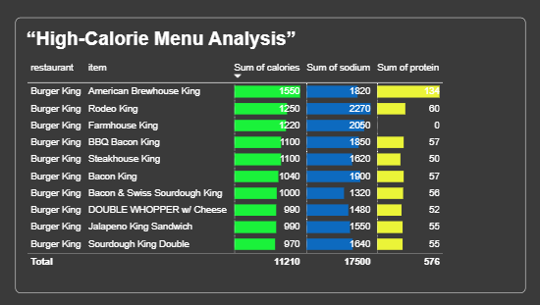
High- Calorie Menu Analysis
This table highlights Burger King’s highest‑calorie items, showing calories, sodium, and protein side by side.
It makes clear that while some items are protein‑rich, they also carry excessive sodium and calorie loads.
The visual supports by providing concrete examples that justify portion control and reformulation solutions.

Slide 8
Recommendations
For Customers
Choose grilled items over fried
Limit double-patty burgers
Avoid high- sodium sides
For Burger king Management:
Market healthier options more aggressively
Reformulate high sodium items
Use data insights to balance taste with nutrition

Slide 9
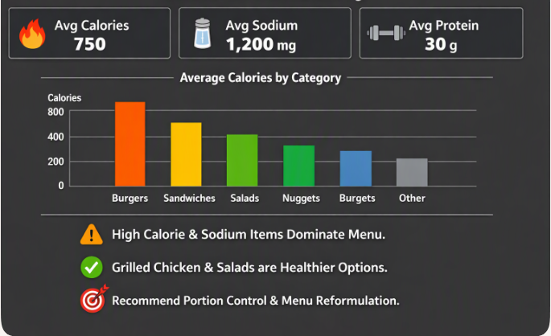
Executive Summary
This slide summarizes Burger King’s nutritional profile and key insights from our analysis.
We can see the average calories, sodium, and protein values at the top, followed by category‑wise calorie comparison.
Overall, the data suggests that portion control and menu reformulation are essential steps toward healthier offerings.

